Slide 1


University of Illinois REU Introduction to MATLAB
Compiled by Erik Huemiller
This is designed to provide guided self learning of using MATLAB for analysis and plotting of data. The self guided part is to enable you to go back later in the summer and relearn/refresh your MATLAB knowledge on your own.
One big frustration is when an error happens that is syntax related. If this happens asking the TA is a good thing to do.

Slide 2
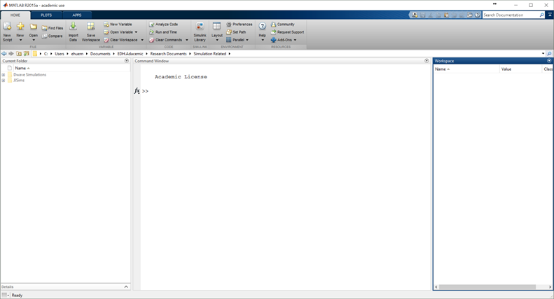
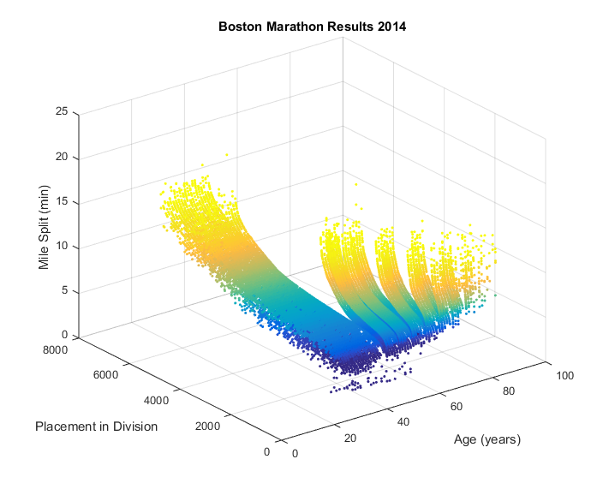
Goals for the REU Crash Course
From where do I type?
Start With
MATLAB loaded on a computer
No prior experience with MATLAB
End with the ability to
Operate in the MATLAB Environment
Create and Import data to visualize it in plots
Fit a model to the data and analyze the error
To plot master!

Slide 3
Resources if you get stuck
MATLAB Documentation
  Easiest to find through a Google search of “MATLAB + command”
  There is example code with an explanation of most commands
  Links to similar commands are listed at the bottom of the page
BYU Intro to MATLAB
  Loosely used as an outline for this crash course
  PDF with less explicit cross references than the online material
Weitzman Institute
  PDF and PPT lectures with slides and example code
  Slow moving course designed for people that have never coded before.
Email grad student mentor with questions
  Slower response, but can give individual feedback
  Can meet up in person to work through a tough problem
  Easiest way to find answers about syntax problems or unknown errors

Slide 4
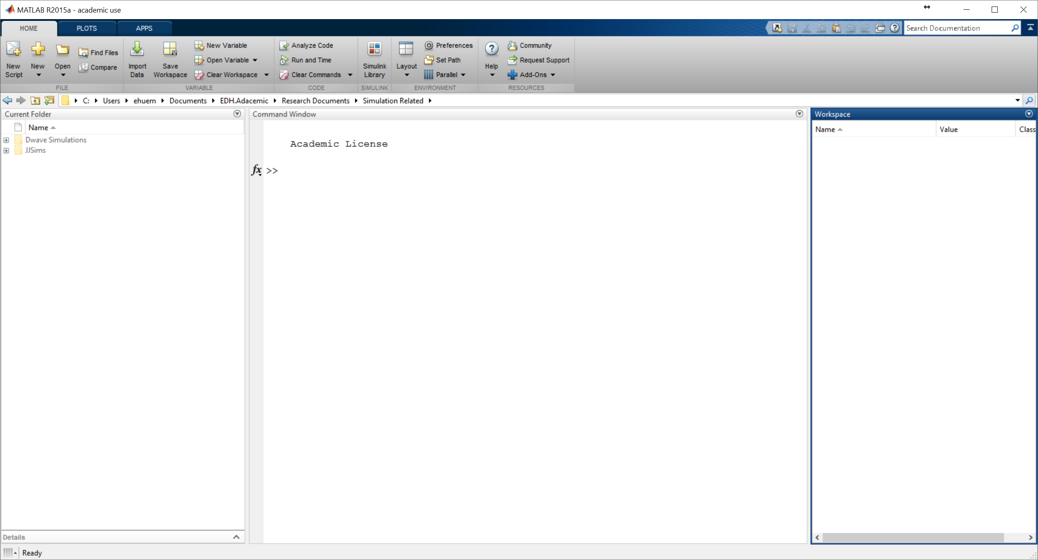
When you open MATLAB
Tools for Running Program
  Saving, Running, Changing Preferences
  This is also the GUI* for plots and apps
Current Folder
  This is where you can find your programs
Command Window
  This is where you enter Commands
  It is also where the output is displayed
Workspace
  This shows variables you have made
*GUI = Graphical User Interface

Slide 5


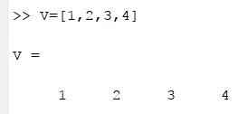
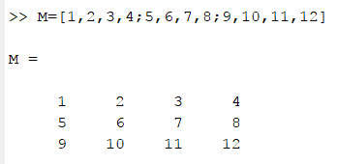
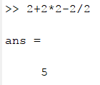
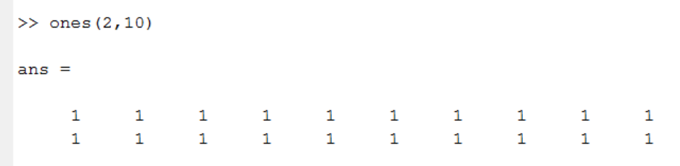
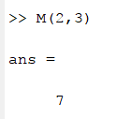
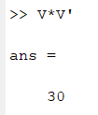

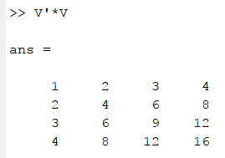
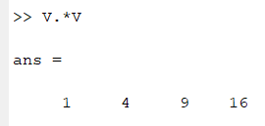

Playing with Variables in MATLAB
Some things to try
Display a string of words
Using it as a calculator (+, -, *, /)
Create a variable (=)
Create a vector and a matrix
Taking the transpose of a matrix (‘)
Create a matrix of ones or zeros
Creating a long matrix without typing it out
Accessing an element of a matrix
Matrix multiplication (* vs .*)
What does adding a “;” at the end of a line do?
What do different clearing commands do (like clear, clc, clear all)?
What happens if you take the sin or cosine of a variable/vector/matrix?
When you do not specify an output variable, MATLAB uses the variable ans, short for answer, to store the results of your calculation.

Slide 6
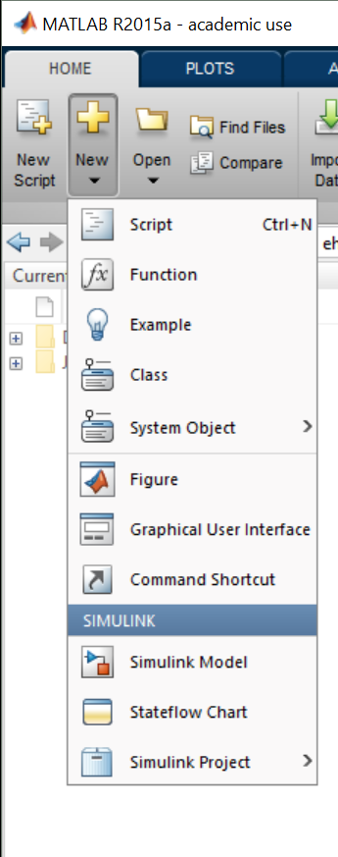
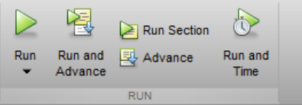
.m files and writing programs
You can write MATLAB code into a file and save it as a .m file. This makes it easier to write and debut larger programs without using the command line. The interface in the script editor also makes it easier to write clean and functional code.
Open a new file here
Try to write a program that will create a variable but not output it yet, print the phrase “Hello World” in the command window and then print the value of the variable squared.
When you have written it, save it in the home directory and hit the run button.
Some notes about file names
Stick with Alpha Numeric
No Spaces allowed (use underscore instead for spaces)
Some notes about Variable Names
Try to make them descriptive in the program
Keep them short so that its easier to type them without mistakes
No spaces allowed (use underscore instead for spaces)

Slide 7

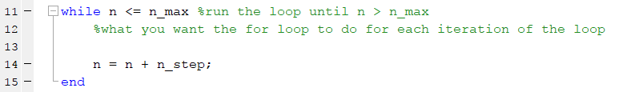
Writing Programs with Loops
For Loops
  The loop runs for values in a range dictated by the input
While Loops
  The Loop runs while an inequality is satisfied.
  Be careful of factors of 1 in this kind of loop.
Try to write a program that sums the first 100 integers using a for loop. Can you make it only count the 10s from 1 to 100?

Slide 8
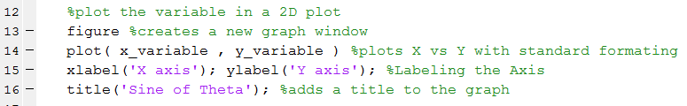
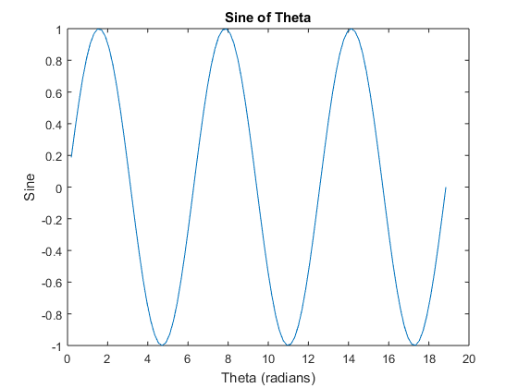
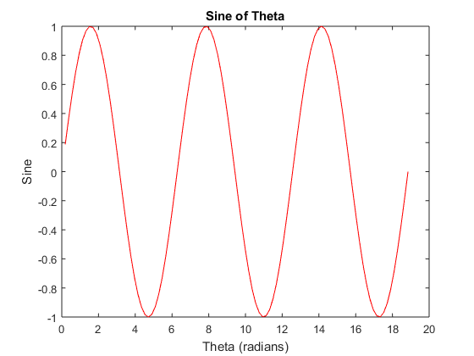
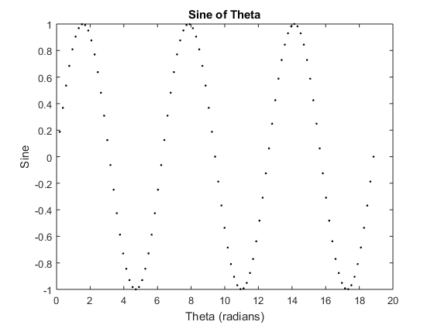
Plotting in 2D and 3D
In Code plotting Order
Plot two variables that are the same length
Add formatting after the second variable if you want
Add labels and a title in the next line
Try to write a program that makes two vectors of equal length (theta, sine) that are 100 points long and are the first 3 periods of a sine function.
Then try to plot them on a 2D plot. It should include axis labels and a title like in the examples (on the right)
Try to change the line to red. Try to change the line to black dots.

Slide 9

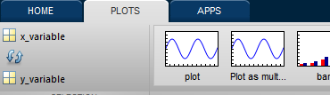
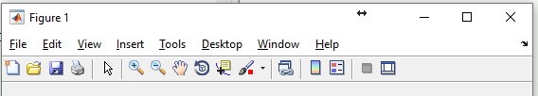
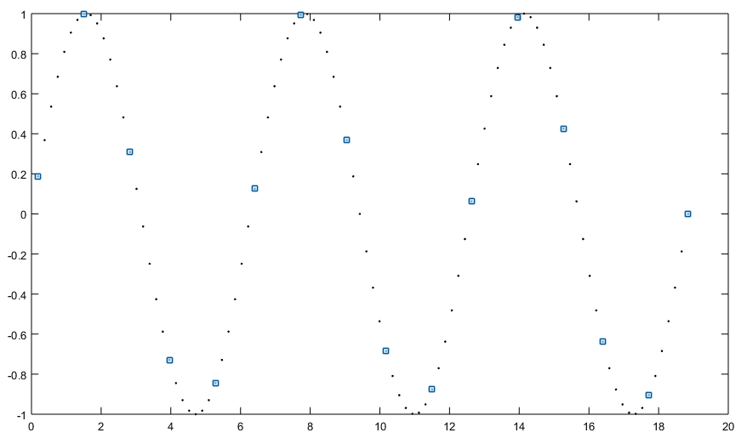
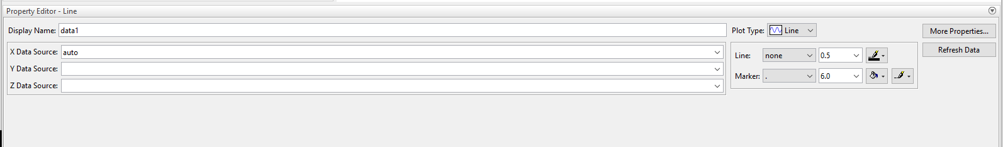
Plotting in 2D and 3D
Using the GUI to plot graphs
Select the variable you want to plot
  Select X then Y for plotting 2D plots
Click on the type of plot you want to use
Open Plot Tools and Dock Figure
Select parts of the graph to configure them
  Use the “edit plot” curser to select parts of the plot
  Blue squares should show up on whatever part is selected for formatting (figure, plot, data)
Use the Property Editor to edit the figure
Try to replicate the graphs from the previous section (slide 12) using the Matlab plotting GUI

Slide 10
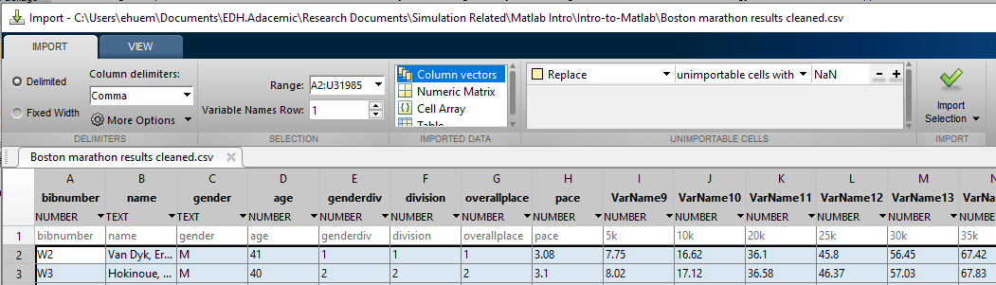
Importing Data
Using Code – MATLAB has support for importing a large variety of different file formats (see here) the easiest of which are csv files (csvread and csvwrite commands) . For this course we will stick to using the drag and drop functionality of the GUI for importing data.
In the GUI – Dragging and dropping the file into the workspace opens the MATLAB import wizard which auto configures correctly for most data files.
Import Selection
Try downloading the Boston Marathon data from the GitHub folder. We want to end up with each column as a vector that is named according to the top row of the file for that column. This will make it easier to work with the data in MATLAB.

Slide 11
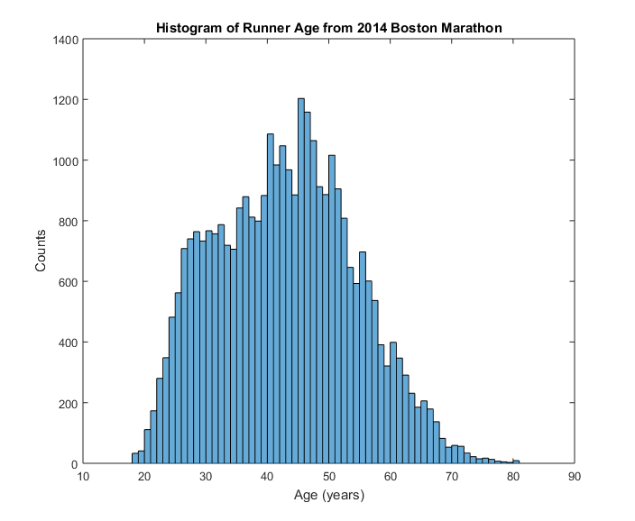
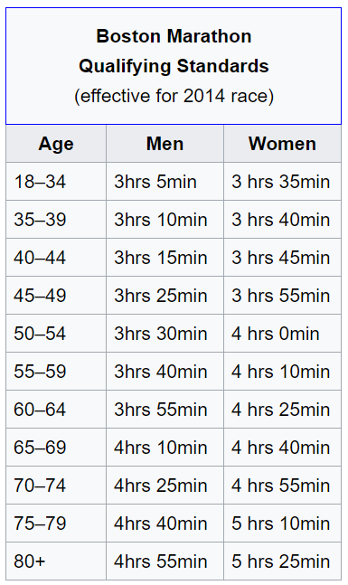
2014 Boston Marathon Data
As the last step, we will explore different plotting functions using the 2014 Boston Marathon Results. The original data can be found on Git Hub here, but a cleaner version is in the MATLAB Intro Folder on Git Hub.
Explanation of Data Labels
  Age – Runner’s Age
  Bib – Runners Bib Number (w# is for wheel chair athletes)
  Divisionplace – Place in their division (age, gender, mobility)
  City – City of Origin
  Country – Country of Residence
  Ctz - Citizenship
  Gender – Male or Female
  Genderplace – Overall Place for their Gender
  Halftime - Half Marathon Time
  Milepace – Average Mile time for the full marathon
  Name – Runner’s Name
  Officialtime – Full Marathon Time (26.2 miles)
  Overallplace – What place did they come in
  State – State of Residence
  Time[X]k – split at X kilometers through the race
Try to use MATLAB to make some plots that provide insight into the results of the Boston Marathon. Here are some examples to get you thinking.

Slide 12
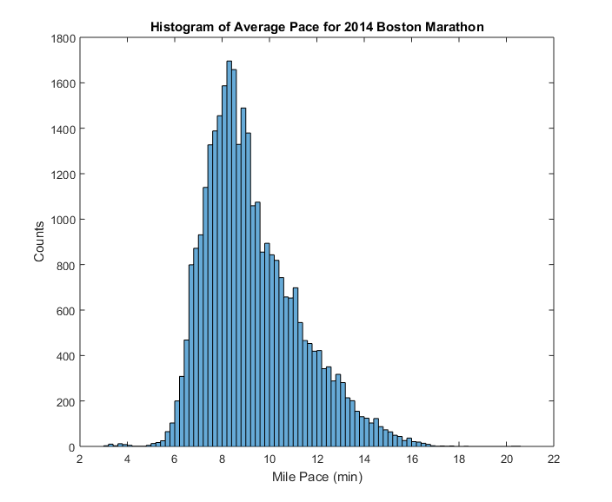
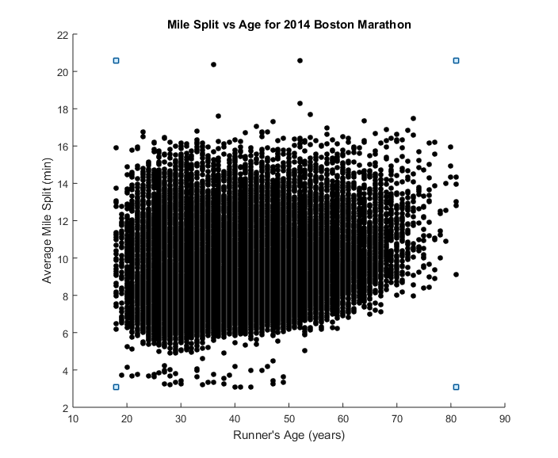
2014 Boston Marathon Data
Some Example Graphs
What are these outliers a result of?

